Slide 1

Boreas and Beyond Project Overview, Releases and Use Cases LFAI OSS NA

Slide 2
Agenda
Acumos AI
What is Acumos AI, Platform Overview
Value and Benefits, Vision
Community
Architecture
Use Cases
RT Video Analytics
Federated Training
5G/ORAN Integration
ONAP/vRAN Integration
Network AI
Releases
Athena
Boreas
Calio
LFAI Landscape & Acumos AI
Machine Learning Stack Proposal
2

Slide 3


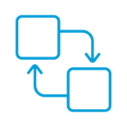

What is Acumos AI?
Open Source Platform to Harmonize AI Solutions
Distributed AI Marketplace
Interoperable Microservices
LFAI Ecosystem to Expedite Collaboration & Innovation

Slide 4










Platform Overview
Download
www.Acumos.org
Create & On-Board Models
Execute In Target Environment
Open Source
Runtime Systems
SciKit
Tensor Flow
R
H2O
Python
Java
Docker
MariaDB
Sonar/ Fossology
Robot Framework
Maven/Jenkins
Nexus
ONAP
AI Development Service and tools
(Scikit-Learn, Tensor Flow, H2O, RCloud)
Reporting / Exceptions
K8/Docker Images
Local Learning
Testing
DNN
Model
Acumos Platform
Onboard
Deploy
Train
Publish
Action
Trainer
DNN
Transform.
Executable
Search
Data Accesss
Feature Recog.
Review
Predictor
License
Feature Recog.
Chain
Data Sources
Data Lakes
Data Router
Training Dataset
Training / Testing Lifecycle
Enhance Model With Application Data
Sharing Models In Marketplace
4

Slide 5
Platform Value and Benefits
Portable Models
Athena
Models Marketplace, Onboarding, Deployment
Portable Training
Boreas
Models licensed and retrained for different purposes
Portable Data
Clio
Reusable Data Pipelines
Models are containerized microservices which can be deployed where necessary to any application. Any system can reuse the logic if it supports Docker.
Models are adapted to different problems through training which can be done anywhere in order to comply with security principles (e.g. HIPAA) even if the model is to be executed elsewhere.
A data pipeline (acquire, select, combine, transform, etc.) can be used with any model so data access can be done once and used to build many solutions.

Slide 6
Acumos AI Vision Is To Provide A Common Tool Umbrella
Models are onboarded from many sources and stored as Docker containers
Marketplace search is aided by a review and rating process
Models can be licensed across organizations
Predefined Data Pipelines collect data from active sources
Security is enhanced by a federation capability
© 2018 AT&T Intellectual Property. All rights reserved. AT&T, Globe logo, Mobilizing Your World and DIRECTV are registered trademarks and service marks of AT&T Intellectual Property and/or AT&T affiliated companies. All other marks are the property of their respective owners. AT&T Proprietary (Internal Use Only). Not for use or disclosure outside the AT&T companies except under written agreement.

Slide 7











Acumos AI Platform Architecture
User
Operator
Modeler
Client
ML Tool
Library
External API Gateway
E2 - Web APIs
E4 - Admin APIs
Acumos Platform Federation
Onboarding
Model
Repository
Design Studio
OA&M
CLI Onboarding
Model Selection
Admin
Dashboard
Acumos
MarketPlace
E1 – Toolkit Onboard
Web Onboarding
Catalogs
Model
Artifacts
Test Data
Data Collection
TOSCA
Topology
Authentication
Validation*
Data Transformation
User
Management
Convertor/Dockerizer
Validate Solution
Notification
Design Canvas (drag & drop)
Security
Management
Acumos
Company X
Onboard
Internal API Services
Monitoring
E5 – Federation APIs
Validation
CDS
Portal/MarketPlace
Federation
Validation Toolkits
Private/Local/Public
Catalogs
OA&M
Database
Acumos
Company Y
Notification/Alert
System Component
Data Model &
Schema Policy & Rules
Policy Enforcement*
Workflow*
Engine
Publishing Model
Portal
User Profile
Performance
Configuration
System Logs
Simulator/Tester*
Importing/Exporting Model
Acumos
Co. Y-1
Validation Dashboard
Model Search/Review/Rating
E7 – License
Management APIs*
E6A – Training APIs*
E6 – Deployment APIs
E3 - OA&M APIs
Target Deployment Environments (including external data sources for training and execution)
Pre-training/Testing
Data
Data Source
e.g. Data Lake
Data Broker
Training Client
Training Cache
Data Source
e.g. Streaming
Data
Data Broker
Execution Client
ML Model
Deployed
7

Slide 8
Acumos AI Open Source Software Technologies and Tools
AI/ML Toolkits
Agile
Code
Data
Test
Code Analysis
Build
Automation
Platform
Deployment
Model
Deployment
Logging Reporting

Slide 9
Use Cases

Slide 10
Video Analytics for Real Time Streaming Data
Streaming Video Analytics powered with following Acumos AI Models :
Object – to classify the images in the video for ad insertion
Sentiment – to detect the mood of the scene for ad insertion
Face Detection – to detect human face
Face Recognition – to recognize well known celebrities
Privacy – to pixelate and provide privacy of the detected faces.
Logo Recognition – to detect various company logos for advertising purposes
Frame Ranking - compute the best frame in the video
Build using Acumos AI open source platform
Uses AT&T Research Labs Acumos AI instance which provides various video analytics machine learning models.
Fast, Easy, Drag and Drop building of complex AI Applications using Acumos AI Design Studio by chaining multiple ML models

Slide 11
Video Analytics System Powered by Acumos AI

Slide 12
Video Analytics Models Chaining in AccuCompose

Slide 13
Video Analytics System Flow

Slide 14



Acumos Collaboration
Acumos Marketplace facilitates iterative ML model development, training and improvement among collaborators
Acumos.org
Catalog
Distribute
Onboard
Model Federation & Improvement
Deploy
Train
Learn
Develop
Historical Data
Company A
Company B

Slide 15


Acumos Vendor Collaboration and Federated Training
Federation
Acumos Marketplace facilitates iterative ML model development, training and improvement among collaborators
Exceptions
Vendor Develops Model
Trains On Ideal Data
Federates Via Acumos
Model Retrained On Actual Data
Model Deployed
Refinements Shared With Collaborators
Onboard
Deploy
Improve
Train
Model Improvements
No Company-specific data
Develop
Train
Learn
Historical Data
Company A
Company B
Ideal Data
Procurement
Licensing

Slide 16
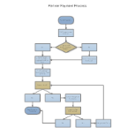






Acumos AI for 5G/O-RAN/Intelligent Controller (RIC)
O-RAN/ONAP platform supports both static policies and more sophisticated dynamic ML/AI models with per-UE control.
Machine Learning Analytic Model Design, Offline Training, Continuous Refinement Environment
Legend
Trained model
Analytic Models
Marketplace Catalog
Predictor Repo
Training Cache
Modeler
O-RAN / xRAN Defined Interfaces
**To be standardized by SDO
Publish models to SDC Catalog
Training Dataset
3GPP Defined Interfaces
Orchestration & Automation (e.g., ONAP, MANO, NMS)
Co-creation Candidate
3rd Party Apps
at the edge
Design
Inventory
Policy
Configuration
RAN Intelligent Controller (RIC) non-RT
5G RAN
A1
RAN Intelligent Controller (RIC) near-RT (CU-CP-H)
Loop 3: > 0.5 sec (policies, orchestration, SON)
Application Layer
Radio Network Information Base
3rd Party App
Radio Connection Mgt.
Mobility Mgt.
Loop 1: per TTI/ msec resource scheduling
QoS Mgt.
Interference Mgt.
Trained Model
Data Distribution Bus API
STEM
Plug-in/ Mediator
E2
RRU:
PHY-low/ RF
NGFI-I
DU: RLC/MAC/
PHY-high
F1
CU-CP-L
CU-UP
RRC
E2
SDAP
PDCP-C
E1
PDCP-U
Standard / Open HW Design
NFVI Platform: Virtualization Layer and COTS Platform
Loop 2: 10 – 500 msecs (resource optimization)
eNB
eNB
16
Cell Sites
AEC
AIC/NTC

Slide 17


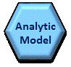
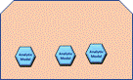
ONAP / Acumos AI Integration
1
Acumos Private Market Place
DCAE Design Studio
SDC Designer
Modeler
5
Service Design & Creation (SDC)
DCAE Analytic
Application Creation
xNF Onboarding
Trained Model Catalogue
Service/xNF / workflow Design
6
Config Design / Controller Design Studio
Analytic Model
4
DCAE Design Studio
Analytic Model
Analytic Model
ONAP Module Deployment Blueprints
Acumos Public Market Place
OOM
Model / Apps
Deployment
3
7
Model training, refinement, & Validation
2
Edge DCAE
Central Data Lake
Edge DCAE
Analytic µServices
Analytic µServices
Validate
(Re)Train
10
Selected, Sampled batch data feed
Performance Analysis
8
3rd Part Optimization
Fault Correlation
Video Optimization
3rd Part Optimization
Fault Correlation
Performance Analysis
Model Driven Analytic Apps
Publish
Video Optimization
Model Driven Analytic Apps
Model Driven Analytic Apps
Model Driven Analytic Apps
Model Driven Analytic Apps
Refine
Model Driven Analytic Apps
…
…
Independent Sampled Data
Historical Data
9
DMaaP
DMaaP
VES Collector
Bulk PM Collector
RT PM / Call Trace Collector
VES Collector
Bulk PM Collector
RT PM / Call Trace Collector

Slide 18
AT&T Network AI
Autonomous, Contexual & Predictive Network to drive new experiences at higher velocity
OPEN SOURCE
AKRAINO/AIRSHIP
Design
Edge Compute
Network AI
ONF/ORAN
SG
Access
Software defined
Network &
Storage
ONAP
Artificial
Intelligence
ACUMOS

Slide 19
Open Source Releases

Slide 20
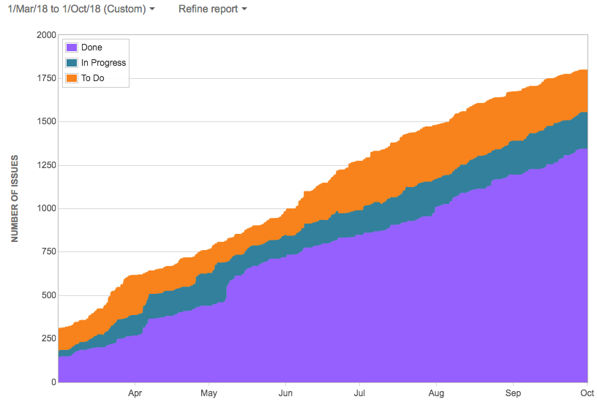
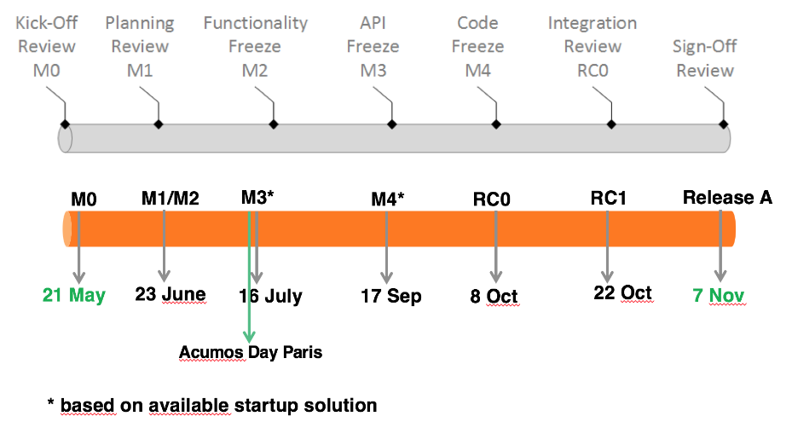
Athena: 1st Open Source Release, Nov 2018
Features
Client Libraries (TensorFlow, ScikitLearn, H2O, R, Java)
O&AM (Admin, Logging, Security)
Design Studio DAG Models Solutions
Onboarding, Micro Services Generation
Cloud/Kubernetes Deployment
Enhanced Marketplace for AI/ML Models
Federation
One Click Platform Deployment
Dataset Management (Seed Code)
ML Workbench Tools (Seed Code)
Model Connector, Runner, Probe
SSO, Personalized UI
Platform Hardening
Key Stats
8 Projects
500K+ lines of code
3K+ Commits
69 Contributors
42 Epics, 176 US, 417 Tasks
1350 Jira Items
100+ Internal API Functional
30+ External API’s
40%+ Code Coverage
59 Repositories
38 Commiters
78 Reviewers
Repo Name | Code Coverage
common-dataservice | 83.2%
generic-model-runner | 68.3%
acumos-nexus-client | 61.9%
runtime-orchestrator | 47%
acumos-hippo-cms | 43.5%
federation | 42.5%
portal-marketplace | 40.4%
design-studio | 37.8%
openstack-client | 33.2%
acumos-java-client | 32.6%
acumos-azure-client | 32.3%
on-boarding | 30.5%

Slide 21
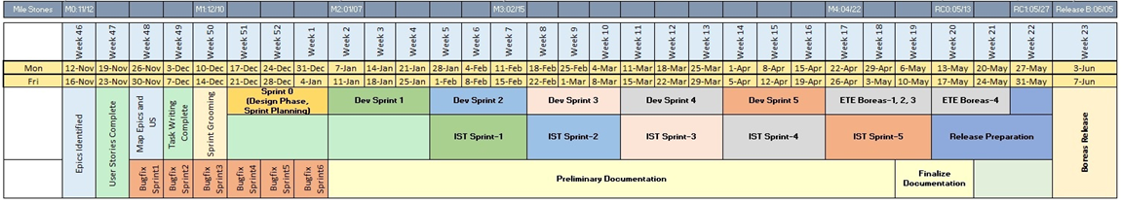
Boreas: 2nd Open Source Release, June 2019
Features
ML Workbench
Kubernetes Deployment
5G Use Cases Federated Training
Model Interoperability ONNX, PFA.
Jupyter Notebooks
Training Pipelines
Licensing
Federation Training
Shared Catalogs
Marketplace Search Integration
Model LCM
Key Stats
8 Projects
1.2M+ lines of code
4.4K+ Commits
110 Contributors
42 Epics, 176 US, 417 Tasks
2872 Jira Items
200+ Internal API Functional
50+ External API’s
50%+ Code Coverage
61 Repositories
114 Commiters
78 Reviewers

Slide 22
Calio: 3rd Open Source Release, Nov 2019 (30% Complete)
Key Stats (30%)
8 Projects
1.27M+ lines of code
4K+ Commits
84 Contributors
33 Epics, 104 US, 28 Tasks
178 Jira Items
200+ Internal API Functional
50+ External API’s
50%+ Code Coverage
62 Repositories
78 Reviewers
Features
O-RAN Integration
MLWB Hardening
Model Scoring
Predictors
Models CI/CD on K8S
IPR Protection
Cross Companies License Usage
Enhanced Catalog Search
Locality / Internationalization
Co-branding
Support C/C++ Client
Support Spark Client
ONAP Integration
NiFi Data Pipelines
MLWB Pluggable Framework Components

Slide 23
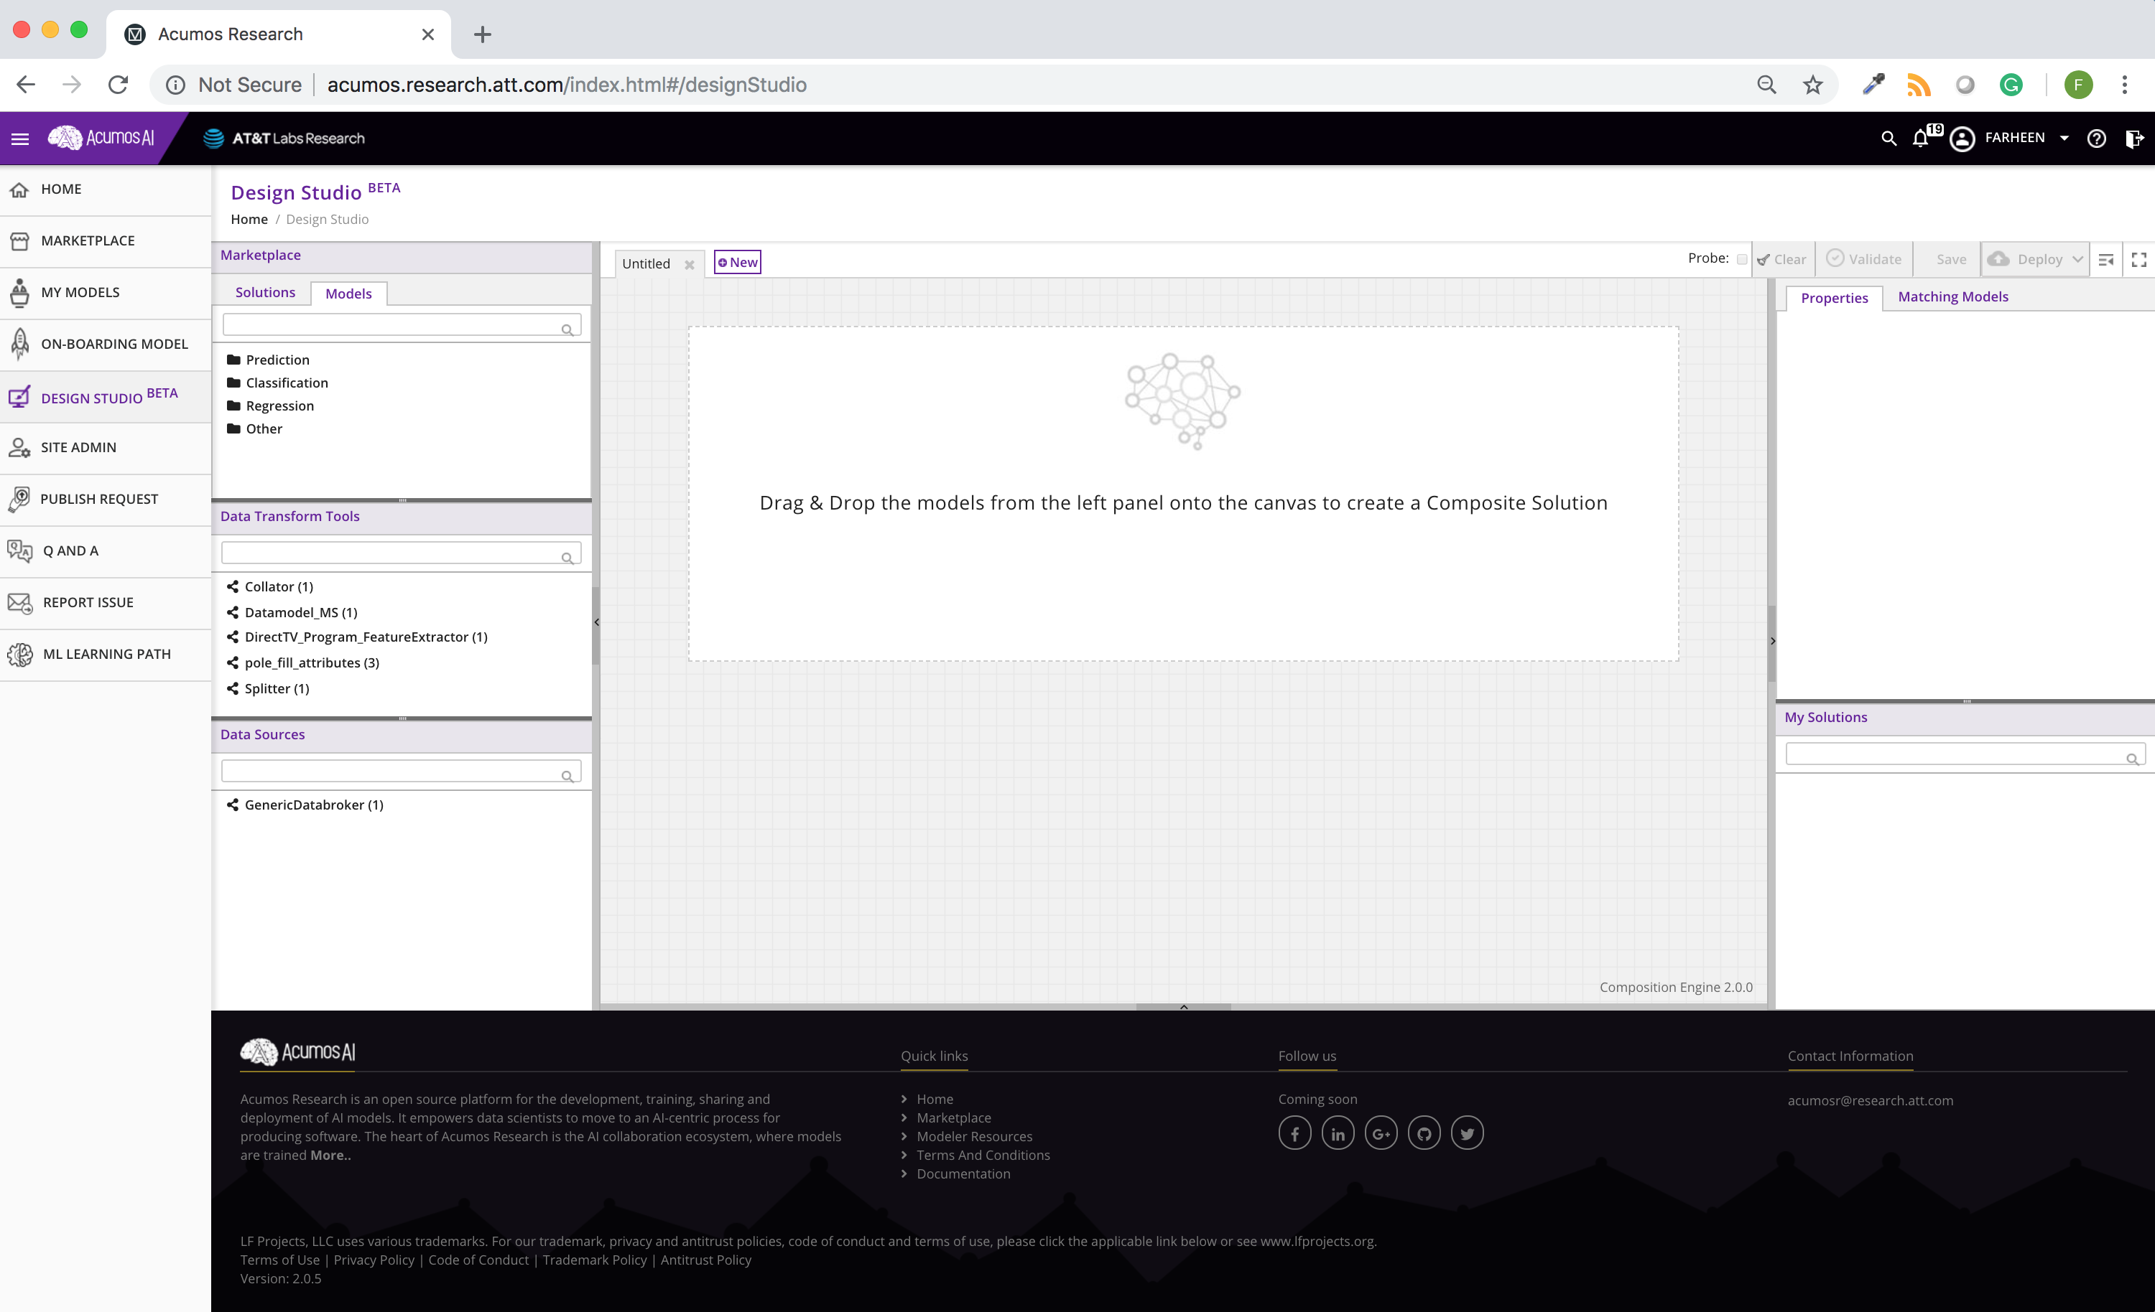
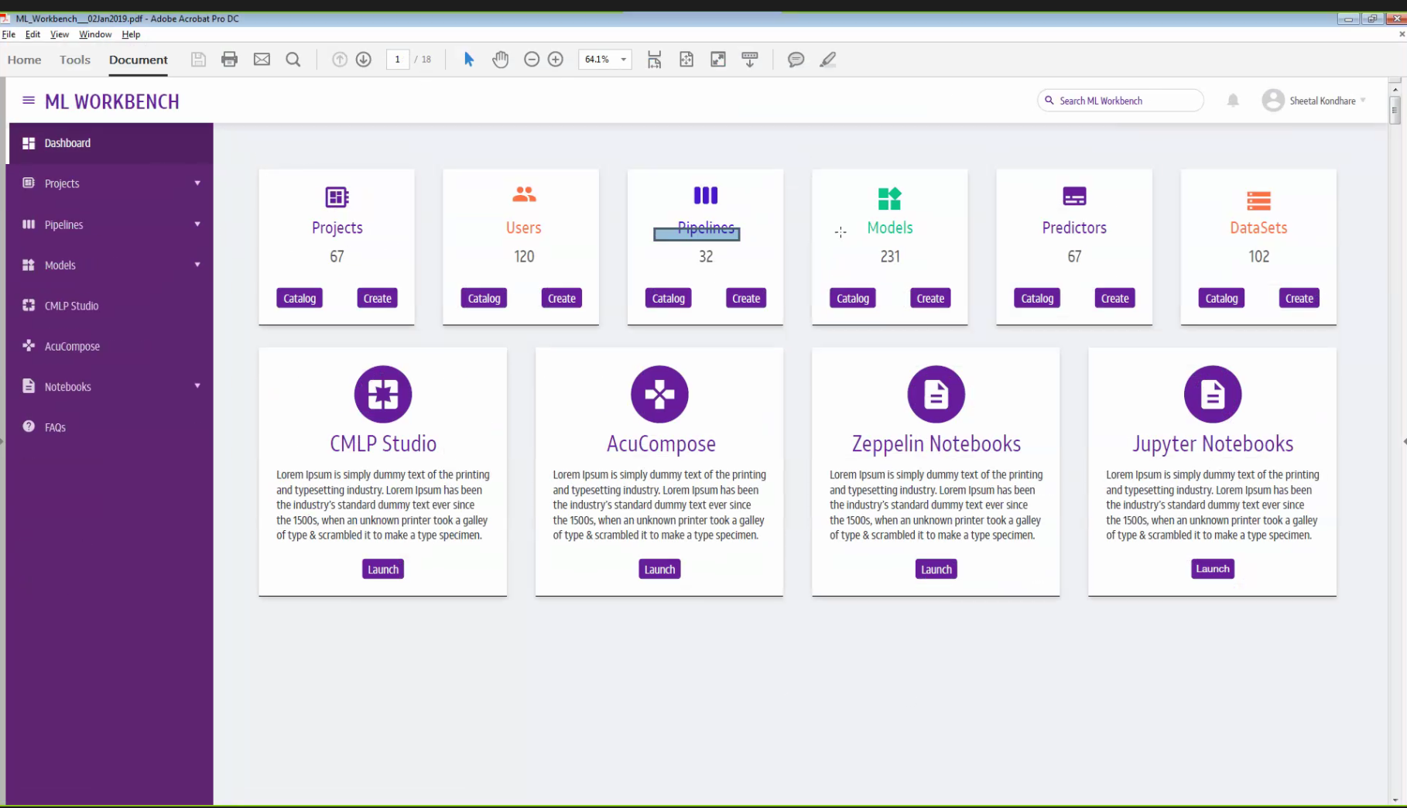
CMLP
/ML Workbench 2.0

Slide 24
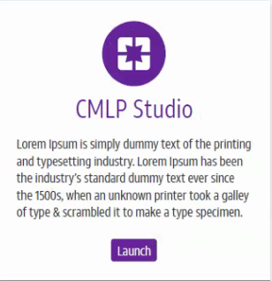
ML Workbench Plug-n-Play Framework for Design Tools
CMLP
ML Workbench 1.0
ML Workbench 2.0
CDO/External Tool

Slide 25
Common Data Services
Provides a storage and query layer
between Acumos system components and a relational database
Server component is a Java Spring-Boot application
that provides REST service to callers
uses Hibernate to manage the persistent store
The client component is a Java library
that provides business objects (models)
methods to simplify the use of the REST service
APIs
code-table
catalog
access
revision
workbench
notification
healthcheck
publish-request
tag
peer
task
artifact
site
right-to-use
role
document
thread
user
solution
25

Slide 26
Federation Gateway (E5)
Provides a mechanism to exchange models between two Acumos instances
Gateway is implemented as a server that listens for requests on a REST API
Public: towards peers (also known as the “E5” interface)
Private: changes between gateway and different adapter implementations
via a secure network channel
provides great flexibility when designing a deployment
The Gateway provides two interfaces, both using REST.
26

Slide 27
Deployment (E6)
Deploy models into OpenShift kubernetes
Logging of deployed models for license management etc.
Deployment of model training and data pipeline components along with model
Deployment of Models to an local environment
Ability to deploy models on their own servers/VMs under a private kubernetes environment, e.g. for testing/training/serving
deploy the models on your own hardware, e.g. workstation or lab servers
27

Slide 28
LFAI Landscape and Acumos AI

Slide 29

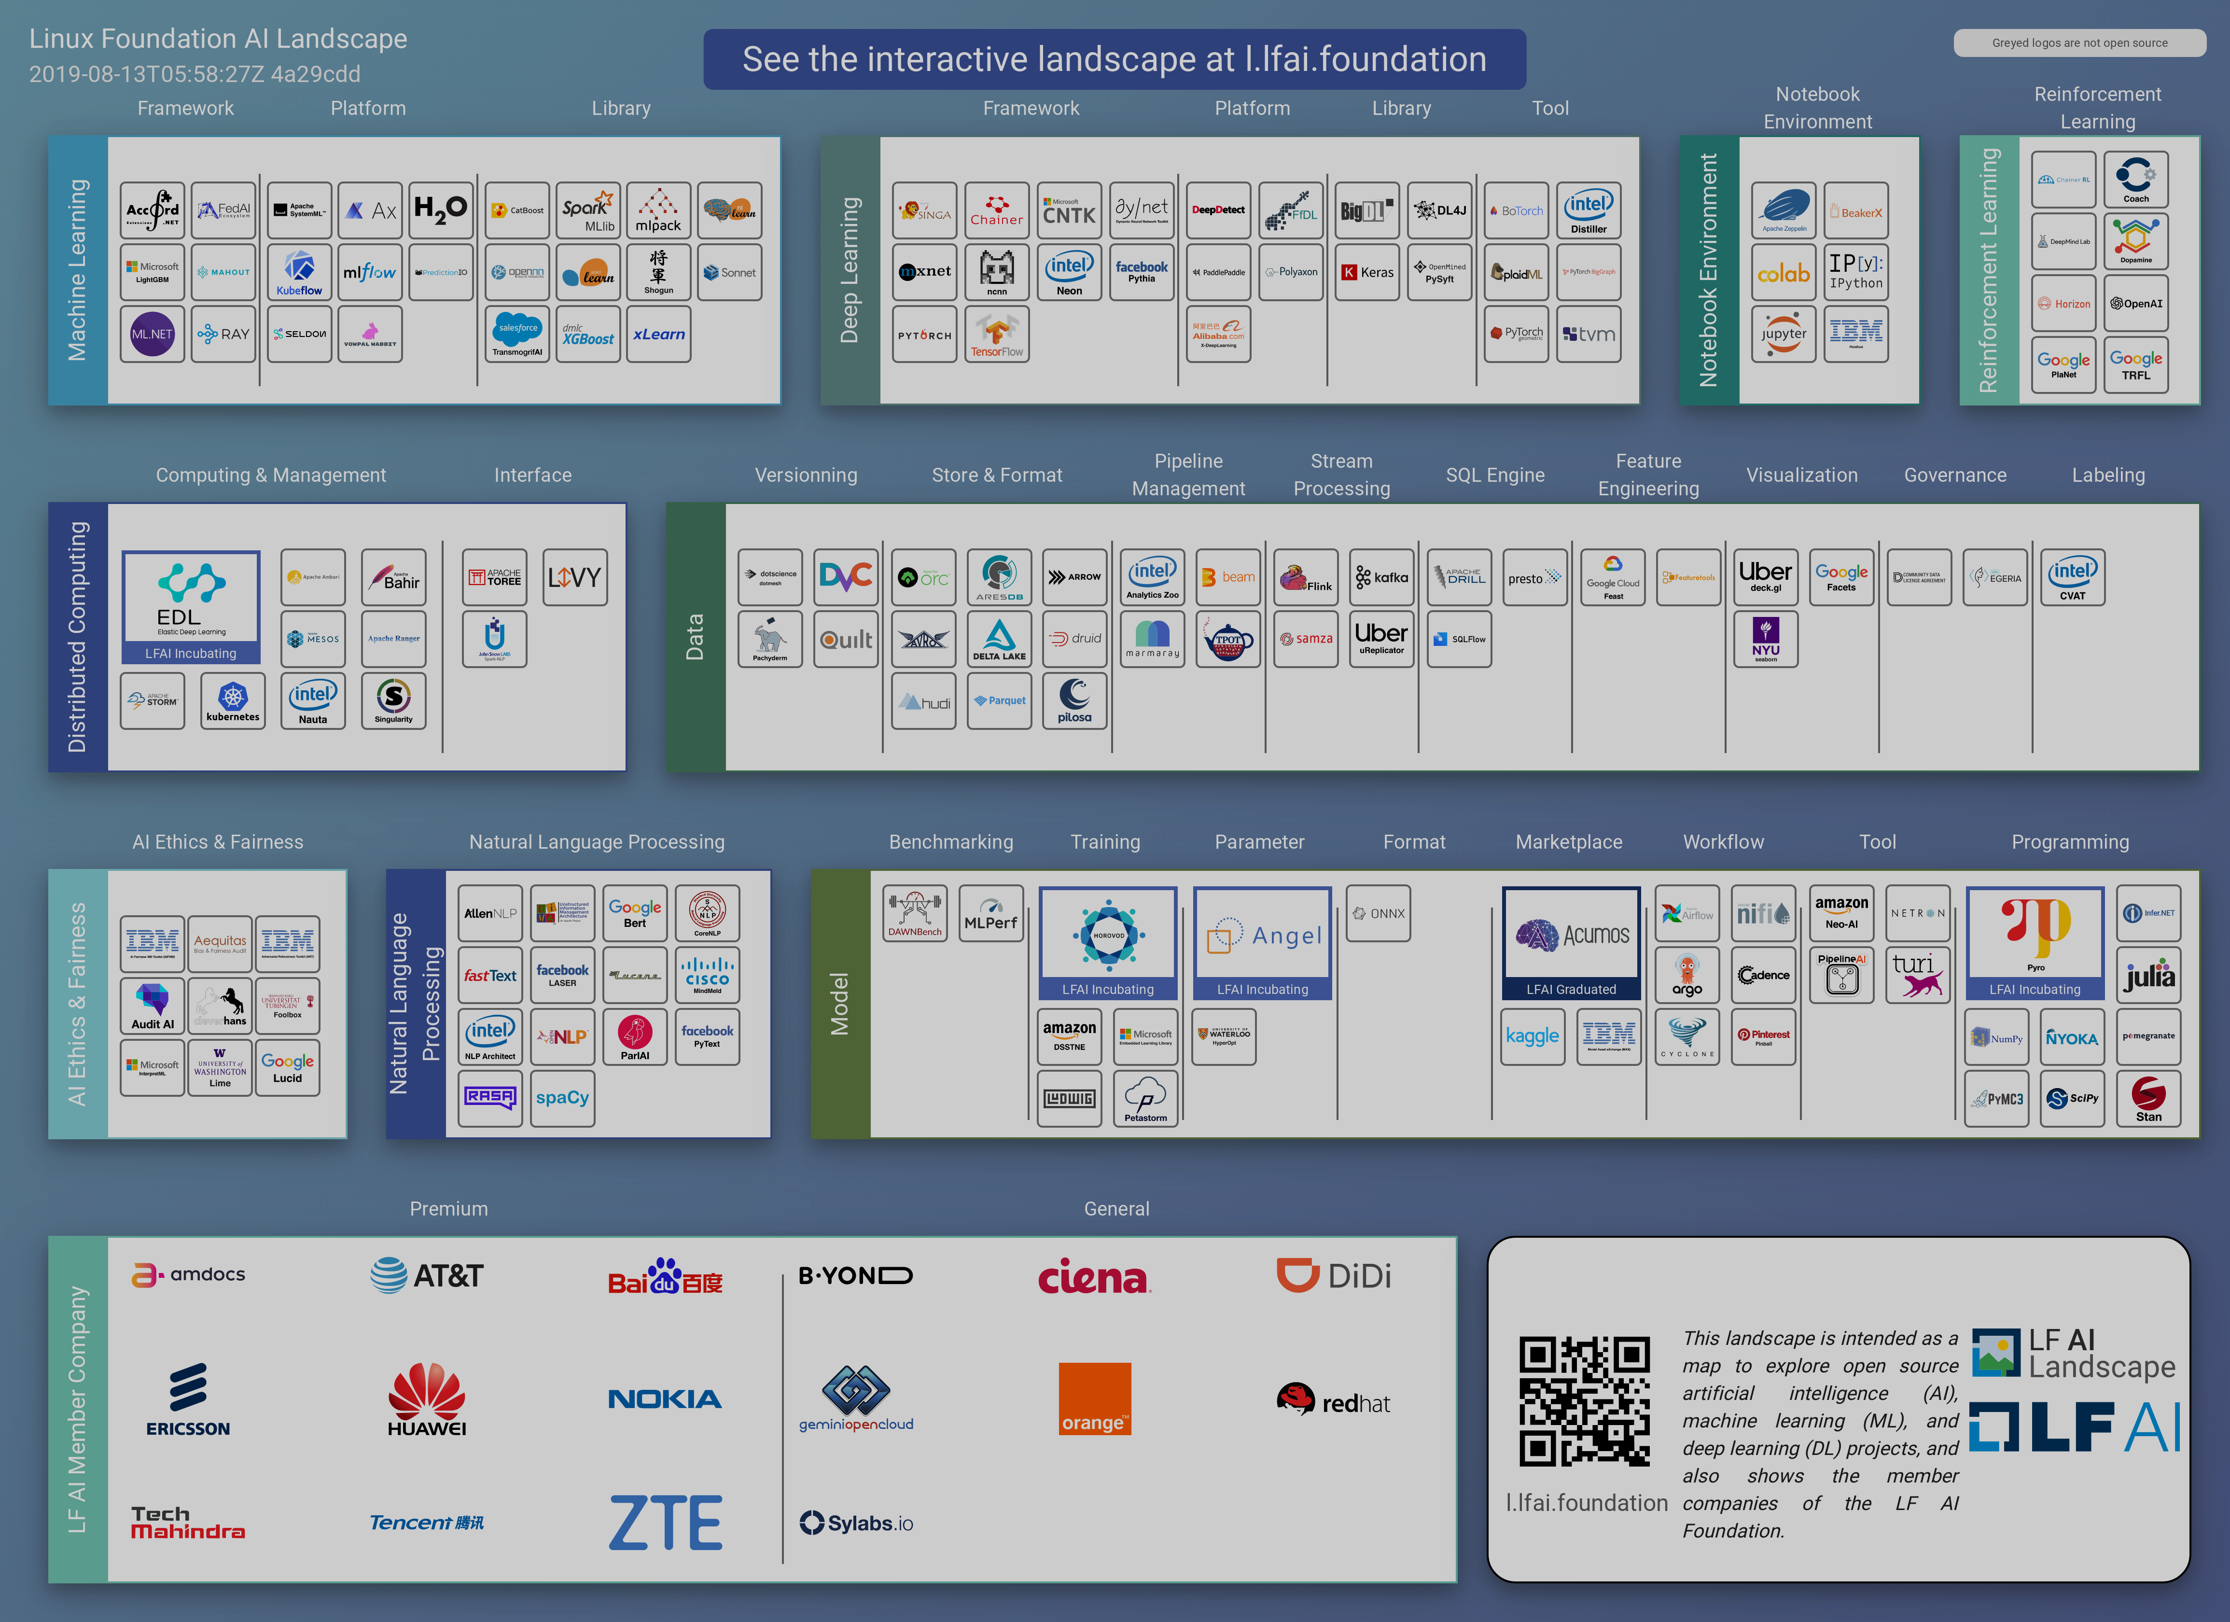
Acumos AI Integration within LFAI Landscape

Slide 30
Machine Learning Stack
Data
Data Governance
Data prep
Data cleansing
Data ingestion
Data analysis
Data transformation
Data validation
Data splitting
Ethics Management
Model creation
Dataflow and Workflow Orchestration
Marketplace (AI Hub)
Building
a model
Training
optimization
Model validation
Training
at scale
Model
Data
Security Management
Rollout
Deploying
Serving
Monitoring & Logging
Finetune & improvements
Cloud
Edge
Model

Slide 31





LFAI Machine Learning Stack
Data
Data Governance
Data prep
Data cleansing
Data ingestion
Data analysis
Data transformation
Data validation
Data splitting
Ethics Management
Model creation
Dataflow and Workflow Orchestration
Marketplace (AI Hub)
Building
a model
Training
optimization
Model validation
Training
at scale
Model
Data
Security Management
Rollout
Deploying
Serving
Monitoring & Logging
Finetune & improvements
Cloud
Edge
Model
Acumos AI Framework Integration (Proposed)

Slide 32




















Open Source Machine Learning Stack
Data
Data Governance
Data prep
Data cleansing
Data ingestion
Data analysis
Data transformation
Data validation
Data splitting
MAX
Ethics Management
Model creation
Dataflow and Workflow Orchestration
Marketplace (AI Hub)
Building
a model
Training
optimization
Model validation
Training
at scale
Model
AIF 360
adversarial-robustness-toolbox
Data
Security Management
Rollout
Deploying
Serving
Monitoring & Logging
Finetune & improvements
Cloud
Edge
Model
AIF 360
Acumos AI Framework Integration (Proposed)

Slide 33
Q&A? Thank You!

Slide 34


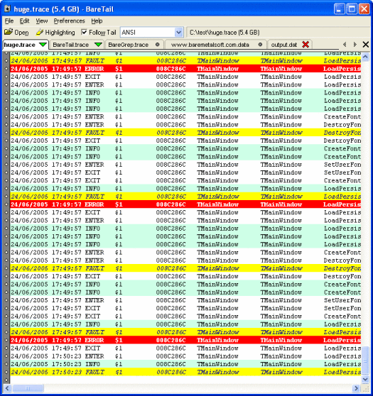
Acumos AI for 5G/O-RAN/Intelligent Controller (RIC)
Slide 12
SDC Designer
7
Integrate
Modeler
Analyst
Publish ONAP
6
Macro Radio
& Small Cell
Antennas
1
Onboard
CLAMP Catalog
Docker Image File
Analytic Model
Marketplace Catalog
5G
Base Stations
Predictor Repo
Design Studio
5
Subscribe
8
DU
RU
5G
Base Stations
Download
Mid Haul
CU-CP-H
Deploy Untrained
Upload Trained
10
2
4
Learn
DU
RU
5G
Base Stations
3
CU-UP
CU-CP-L
External Training Client
(Train & Retrain Models)
STEM RT
Training Model
Data Broker -DB
Training Cache
Front Haul
Select Training Data
9
DMaaP
DU
RU
Real Time Data Collector
Analyze
DCAE Analytic Function
Data Lake
Data Broker
RT
DCAE Model Runner
Trained Model
34
34

Slide 35
Acumos AI Boreas release – other benefits
Deploy Acumos platform under OpenShift Kubernetes
Deployment of data pipeline components along with model
License scans of models and metadata
Support licenses and Right-To-Use for proprietary models
Onboarding of ONNX, PFA and Dockerized models
Enhanced user experience in portal - Publishing, unpublishing, deploying and onboarding, model building, chaining, etc.
Enhanced system peering through a controlled process of partner catalog publication and subscription - Global catalog search capability

Slide 36
Accomplishments – 2018
AT&T Spark DevChallenge
Acumos integration phase 1 completed: models onboarding, microservices generation, federation to CMLP, deployment to CDP Kubernetes, full catalog integration.
Launched and completed Acumos AI Challenge to expand awareness of AT&T’s position in AI while growing Acumos AI model catalog,
CMLP
50k+ lines of code migration to Acumos AI LF open source code repositories for CI/CD process.
Acumos Day Paris Conference
Supported Acumos Day conference led by Orange, 100+ participants, co-sponsored by Nokia.
Showcased open source Analytics and AI strategies from operators' and vendors' perspective.
Infrastructure
Setup and configuration of Acumos Lab for ONAP, ONS, and Open Source community
Open Source Releases
Open Source Community
1st Acumos public release announcement
ONS March 2018
Athena November 2018
First AT&T AI Marketplace
100+ AI Models, 130+ Users, 45+ CI/CD builds, federated with internal & external Acumos marketplaces for sharing
23 presenters from 11 different organizations. with over 70 in-person and 100+ virtual attendees
Linux Foundation Deep Learning creation, lead by AT&T
Acumos TSC creation, lead by AT&T
16 community organizations joined LFDL
Acumos Day NYC Conference

Slide 37
Acumos AI Update
Boreas Release, June 7
M0-M4 Completed, 5 Dev sprints, ETE Test in progress
CMLP Co-create, ML Work Bench, Notebook, Pipelines, Licensing, Federation, Shared Catalogs, Search Integration
Clio Release, Nov 15
M0/1/2 Completed, Dev Started,
ONAP Integration, ORAN/RIC Integration, Public/Searchable Catalogs, Training, Data Sets Catalog, Spark/C++, Native K8S support,
AI4EU Collaboration
PTL/TSC Election
Committee: Product/Community, Security, Architecture
PTL: Model Onboarding, Portal and UX, Integration and Test, Catalog, Data Model, Data Management, Training, Design Studio, De;ployment, Common Services, Documentation, License, O&AM
AT&T AI Marketplace Integration
Industry Events
Boreas/Acumos AI Release, June 2019
June 17th - ITU-T Machine Learning 5G workshop, Geneva, ZTE/Orange.
June 24th - KubeCon + CloudNativeCon, Open Source Summit China 2019, Acumos AI Federated Telecom AI Marketplaces, Huawei
June 26th – MWC2019 at Shanghai, 5G, IOT, AI, Big Data
Aug 20th - Open Source NA LFAI Summit, Sandiago, CA
Oct 22nd - OSS Summit, Europe, Orange.
LFAI Day China (ZTE, Huawei), Europe (Orange), India (TechM)
Acumos-R
113+Public/190+Private uS, 249+ users, 1k+ downloads, Weekly CICD, CDO/TD/LF/TechM/Ericsson Federation
ML Workshop with 400+ users, 150+ models onboarded
5G/RIC Collaboration
Ericsson vMME/5G/Loop3, Nokia use cases
NJIT, NYU Research collaboration
37

